Slide 1
Computational Thinking, Problem Solving, and Programming
TOPIC 4.0 – Computational thinking
TOPIC 4
4.1.17 – 4.1.20: Thinking Abstractly

Slide 2

REVIEW REVIEW REVIEW REVIEW REVIEW REVIEW
THE WARM-UP QUESTION
Create a pseudocode algorithm to output whether a movie is ‘certified fresh’, ‘fresh’, or ‘rotten’ on Rotten tomatoes.
Take input for the number of positive and negative reviews
A movie is fresh if 60% or more reviews are positive, rotten if less than 60% are positive, and certified fresh if reviews are over 70% positive, and there are over 80 total reviews

Slide 3
TOPIC 4.1.4 – THINKING Logically
THE WARM-UP QUESTION
POSITIVE = input(“Number of positive reviews”)
NEGATIVE = input(“Number of negative reviews”)
TOTAL = NEGATIVE + POSITIVE
If POSITIVE / TOTAL >= 0.7 and TOTAL >= 80 then
output “Certified Fresh!”
else if POSITIVE / TOTAL >= 0.6 then
output “Fresh”
else
output “Rotten”
end if

Slide 4

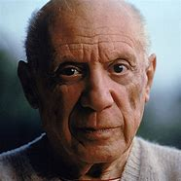
TOPIC 4.1.17 – THINKING ABSTRACTLY
ABSTRACTION
Computer Science is ALL about abstraction
We simplify the real world and the things it contains into simplified concepts
We simplify the parts that are relevant to our problem, taking away what we don’t need
Think of abstract art as it represents the real world while being different than it
Abstraction
Big nose
lookin’
guy
Picasso

Slide 5
TOPIC 4.1.17 – THINKING ABSTRACTLY
ABSTRACTION
For example, when we write programs we don’t have to think of the physical chips, CPU, RAM, or otherwise
If you thought we did I bet you’re relieved right now
Computer abstracts these components for us so they’re easy to use
Abstraction is a fundamental concept of computing, and we will explore specific instances of it in detail later

Slide 6
TOPIC 4.1.18 – THINKING ABSTRACTLY
WHY IS ABSTRACTION REQUIRED?
If we tried to represent every detail of the real world our computers wouldn’t be able to handle it all
Unless you believe we live in a simulation, more power to you
Let’s take a look at Minecraft as an example of a real world abstraction

Slide 7
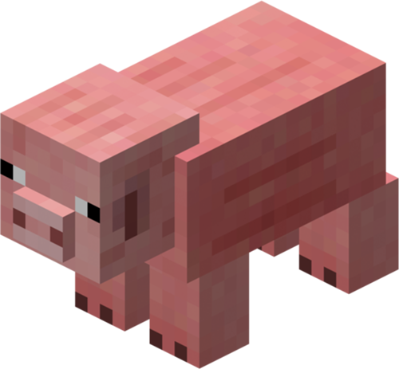
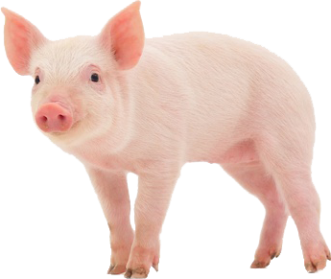
TOPIC 4.1.18 – THINKING ABSTRACTLY
OH YEAH, Minecraft
Real life pig
Individual hairs
Individual cells
Complex immune system
A brain that thinks like a 3-year-old
Minecraft pig
A texture image
Health points
Status effects
Follows you if you hold a carrot

Slide 8

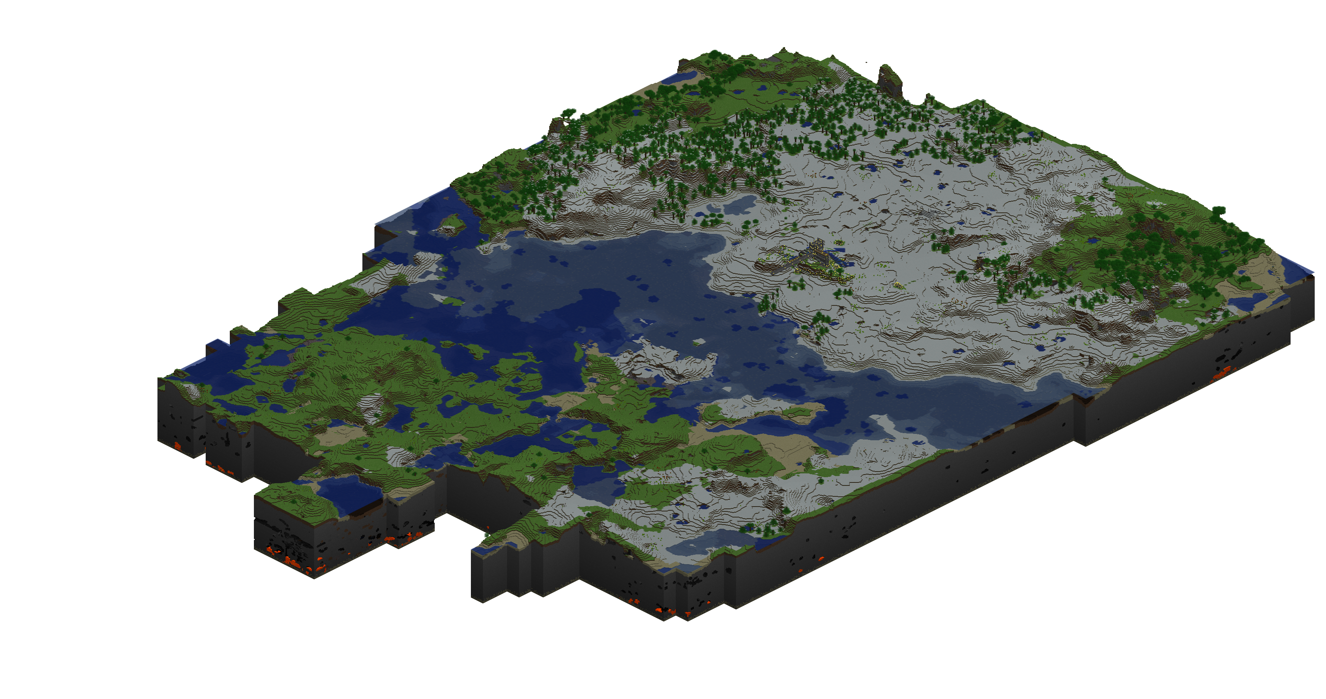
TOPIC 4.1.18 – THINKING ABSTRACTLY
OH YEAH, Minecraft
Real World
Thousands of different ecosystems
Millions of types of creatures
Infinitely varied terrain
Minecraft world
Less than 100 biomes
Less than 100 creatures
Terrain that consists of ~200 blocks of depth

Slide 9
TOPIC 4.1.18 – THINKING ABSTRACTLY
OH YEAH, Minecraft
Obviously, our world is way more complicated than a game world
It’s our job to decide what to take, what to keep, and what to simplify

Slide 10
TOPIC 4.1.18 – THINKING ABSTRACTLY
OBJECTs
We keep talking about all of this information
How do we actually use info like this in an algorithm?
Programs can contain objects
Objects contain data about the real-world object they abstract
A person object could keep data about them like:
Name
Birthdate
Address
Eye Color
Social Security Number
Data kept in object depends on purpose of program

Slide 11
TOPIC 4.1.18 – THINKING ABSTRACTLY
OBJECT Example
If I’m organizing a volunteer event, I have people sign up for that event, and I store their information in a database of people objects
What information do I need?
Everything about them?
Number of hairs?
Age (by the second)?

Slide 12
TOPIC 4.1.18 – THINKING ABSTRACTLY
More examples
If I’m creating a movie review website, and I store the movie info in the database of movie objects
What information do I need?
Everything about the movie?
Each person who worked on the movie?
Every frame of the movie as a screenshot?

Slide 13

TOPIC 4.1.18 – THINKING ABSTRACTLY
More examples
If I’m creating a pet shop that sells fish, what information do I need to store in my database of fish objects?
There’s no one correct answer to a problem like this!
Look at the subject and figure out what information will be valuable when creating our system

Slide 14
TOPIC 4.1.19 – THINKING ABSTRACTLY
ABSTRACTING AT SCALE
Now, what if what we abstract isn’t as simple as a creature or object?
Looking at a school, we can abstract it into a hierarchy like this
School
Grade Levels
Departments
Faculty
Students
Schools have Departments with Faculty, and GradeLevels have Students
All of these can be represented independently as objects, or as a group

Slide 15
TOPIC 4.1.19 – THINKING ABSTRACTLY
ABSTRACTING AT SCALE
Let’s abstract the GOVERNMENT!!! YEAH!!!!
Highest Level: Government
Branches
Committees
Congress
House
Senate
Congressman
Judge

Slide 16
TOPIC 4.1.19 – THINKING ABSTRACTLY
PUTTING IT TOGETHER
All of these objects in the government are working at the same time, what’s that called?
Concurrency!
They can all be simplified, what do we call that process?
Abstraction!
They are all doing their own set of tasks. What do we call the set of tasks?
Algorithm!
Woo hoo!

Slide 17
TOPIC 4.1.20 – THINKING ABSTRACTLY
Final notes
Make sure that you don’t apply this logic to the real world
We are all infinitely complicated
Abstraction works well for computer programs, but in real life you must be nuanced and careful

Slide 18
TOPIC 4.1.19 – THINKING ABSTRACTLY
Final ACTIVITY
Think of three objects/creatures/people you interact with on a regular basis.
If you were in a game like Minecraft (or other you can pick), what would you abstract that object/creature/or person into?
Feel free to be creative with it!

Slide 19

TOPIC 4.1.19 – THINKING Logically
VOCAB TO REMEMBER
Abstraction
Objects

